Slide 1
Outline of Workshop
First thing: How to use Jupyter Notebooks Morning (pre-break):
Introduction to statistics and spatial-temporal autocorrelation
Simulations to understand concepts of autocorrelation and stochastic realization
Morning (post-break):
Understanding the consequences of space-time autocorrelation for scientific inferences
Code and hands-on time to fit various time series and spatial models
Afternoon:
Analyze three datasets of varying size and complexity (time vs. space vs. space/time
3pm presentations of Jupyter notebooks to give updates and tips

Slide 2
How to use Jupyter

Slide 3
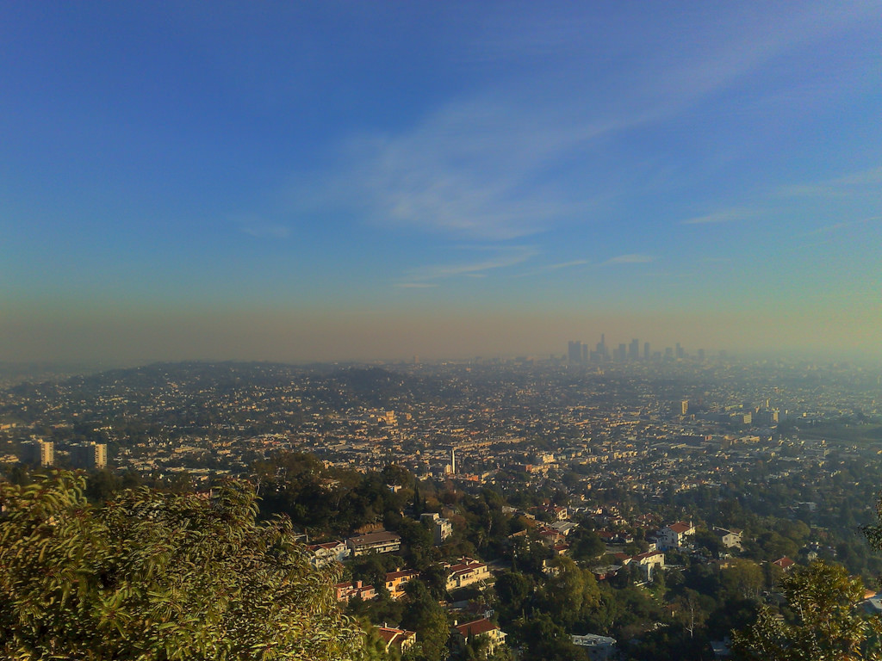







An Introduction to Environmental Statistics
UCI Data Science Initiative Short Course Gregory Britten (gbritten@uci.edu), Yara Mohajerani (ymohajer@uci.edu)

Slide 4
Is there a statistical trend in observed air quality? Are times of the year systematically worse? What environmental factors contribute to the trend?

Slide 5
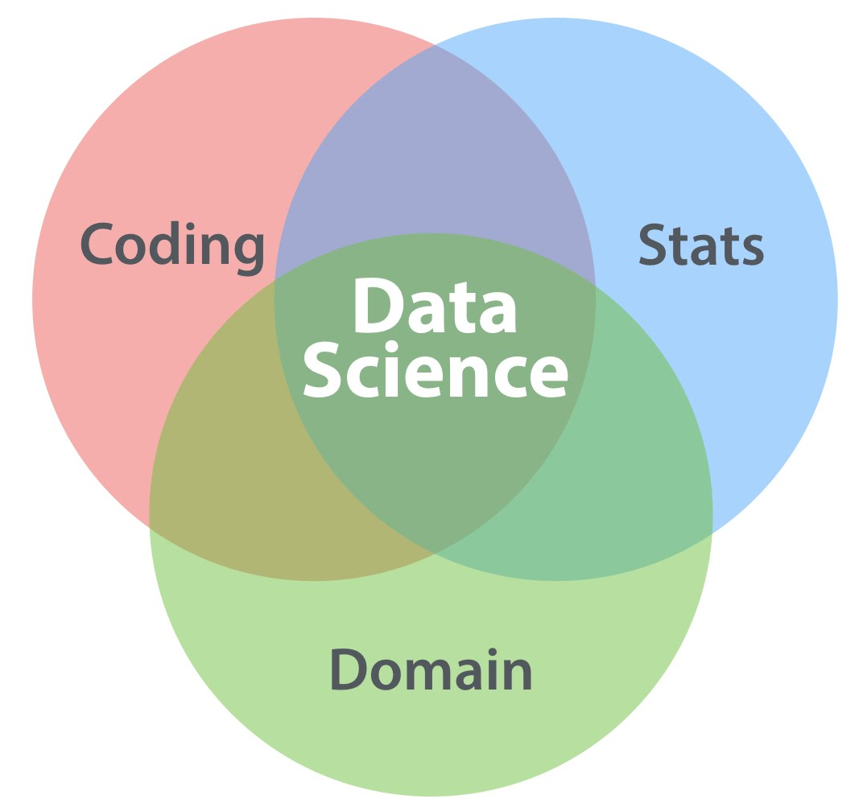
Goals of Applied Statistics
Goal of statistics is to learn about the data-generating process
Goals of applied statistics thus often aligned with applied science
Today
DATALAB.CC

Slide 6
Characteristics of environmental data
Collected in time and/or space
Seasonal, daily, and other cycles
Colinearity among variables
Observational, measurement error

Slide 7
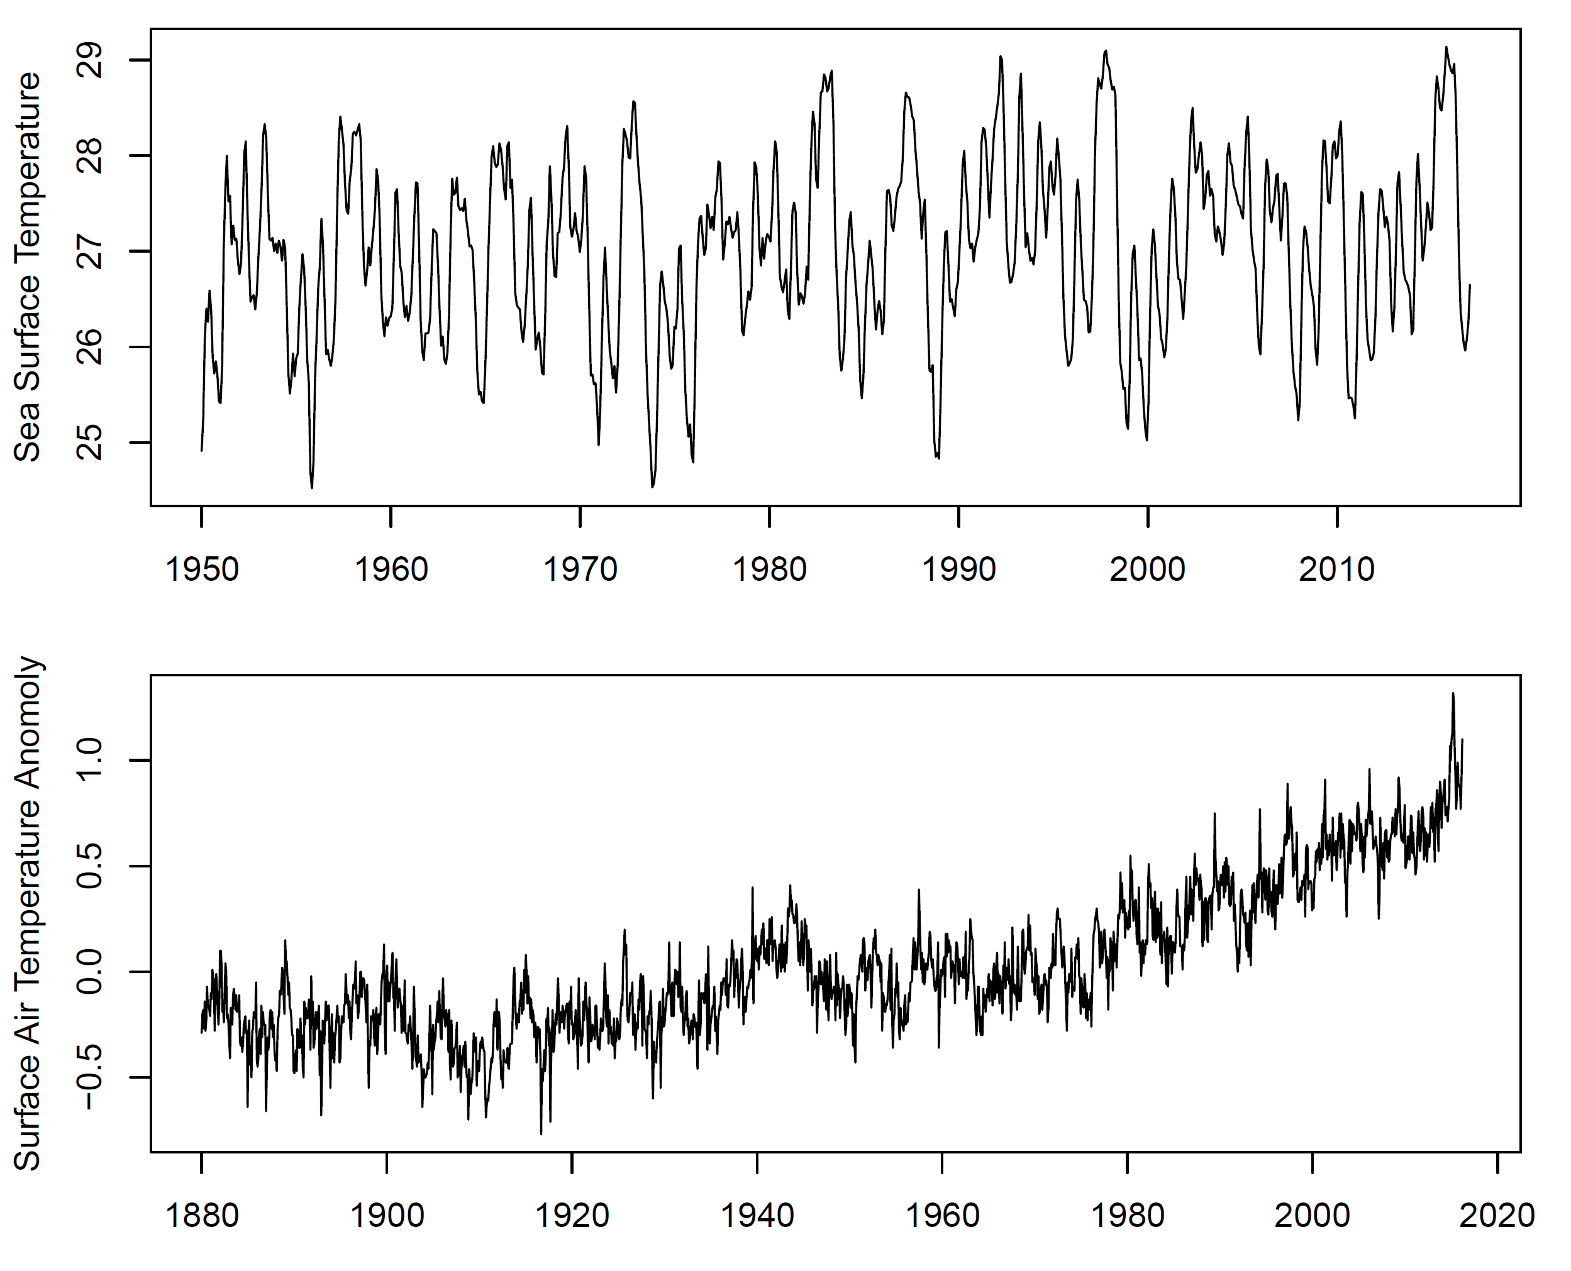
Sea Surface Temperature
Global mean monthly air temperature anomaly
Periodicity, trend, ‘runs’

Slide 8
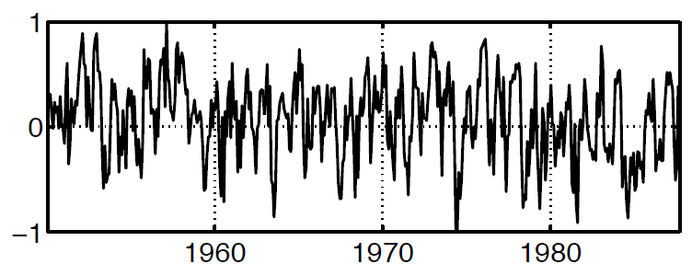
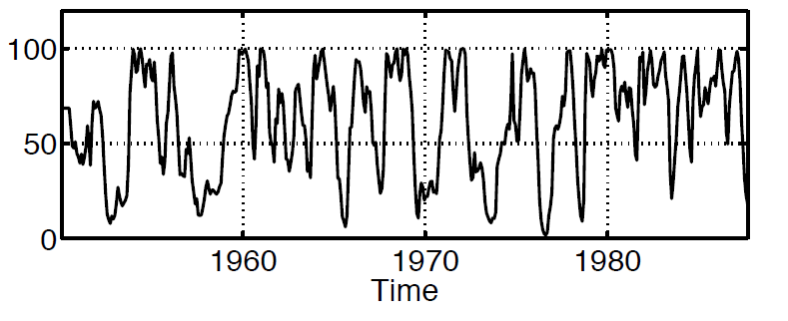
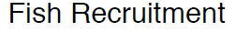
Often interested in relation among variables

Slide 9
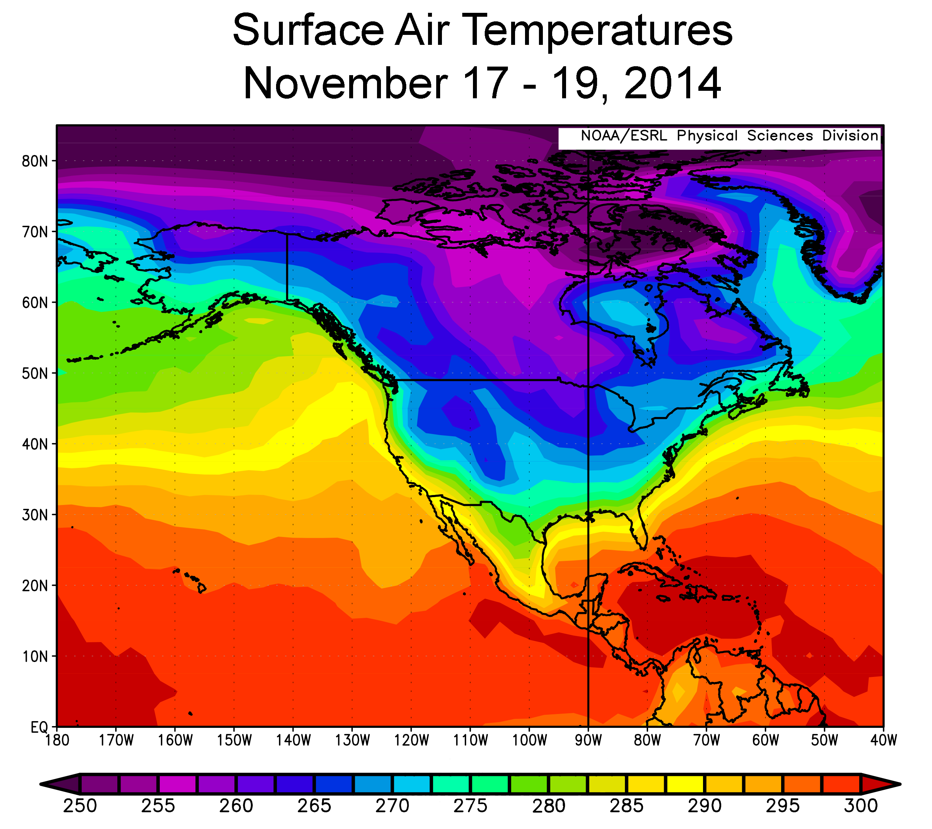


Slide 10
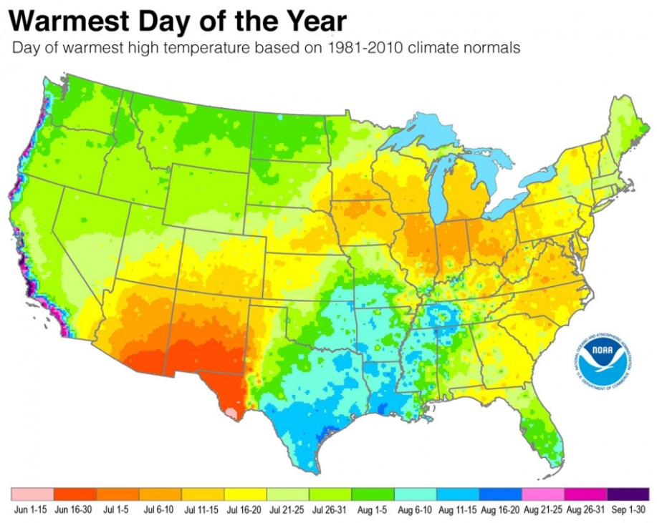
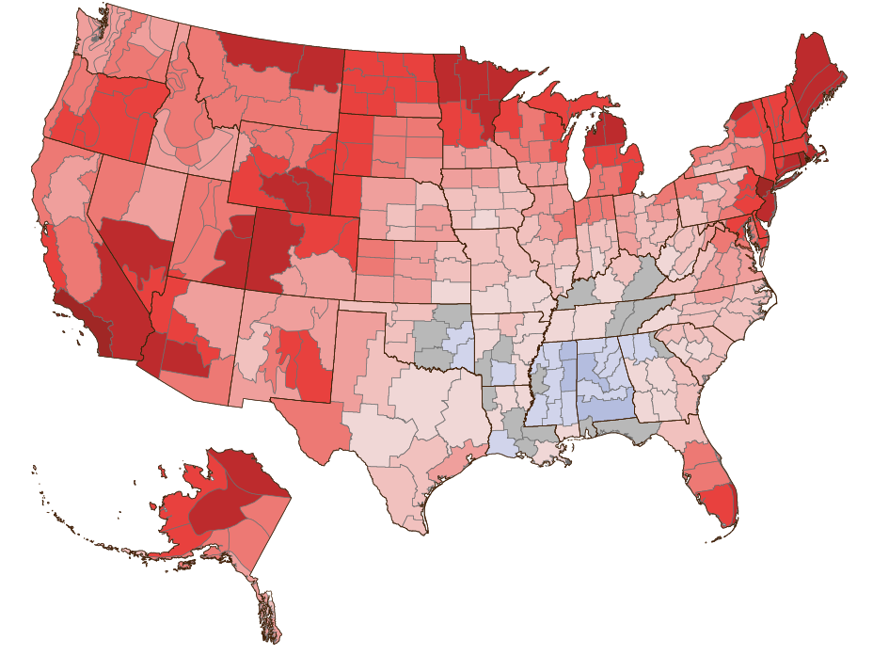
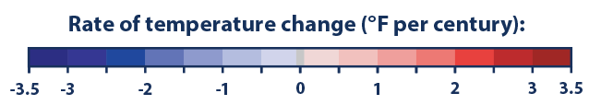
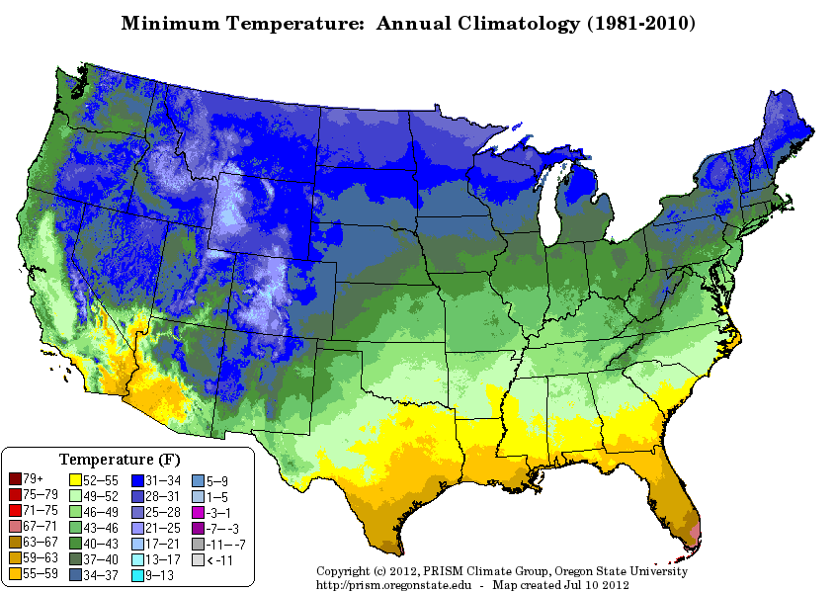
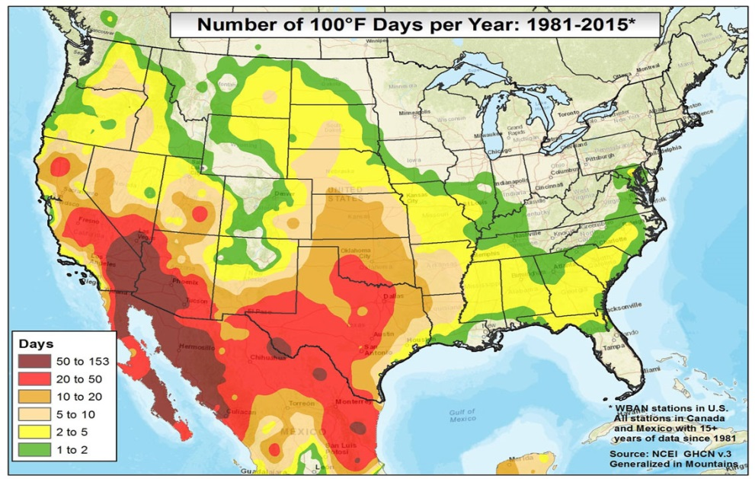

Slide 11

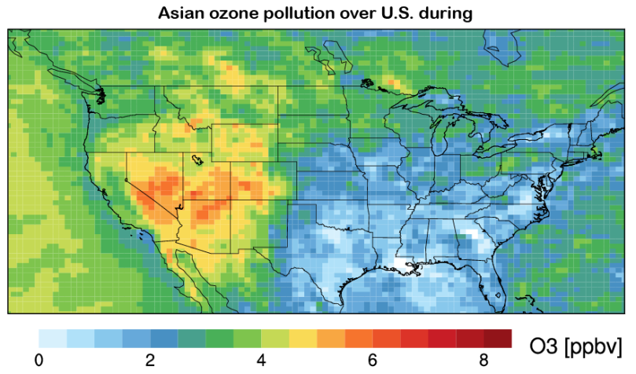
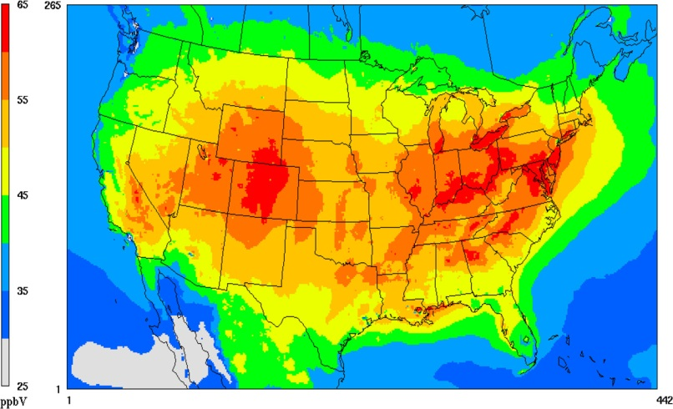
Utah department of environment claims research demonstrates Asian source of ozone, meaning the state is not in violation of EPA Empirical science hotly contested: statisticians to the rescue!
We will see how properly treating spatial/temporal properties is critical to empirical inference

Slide 12
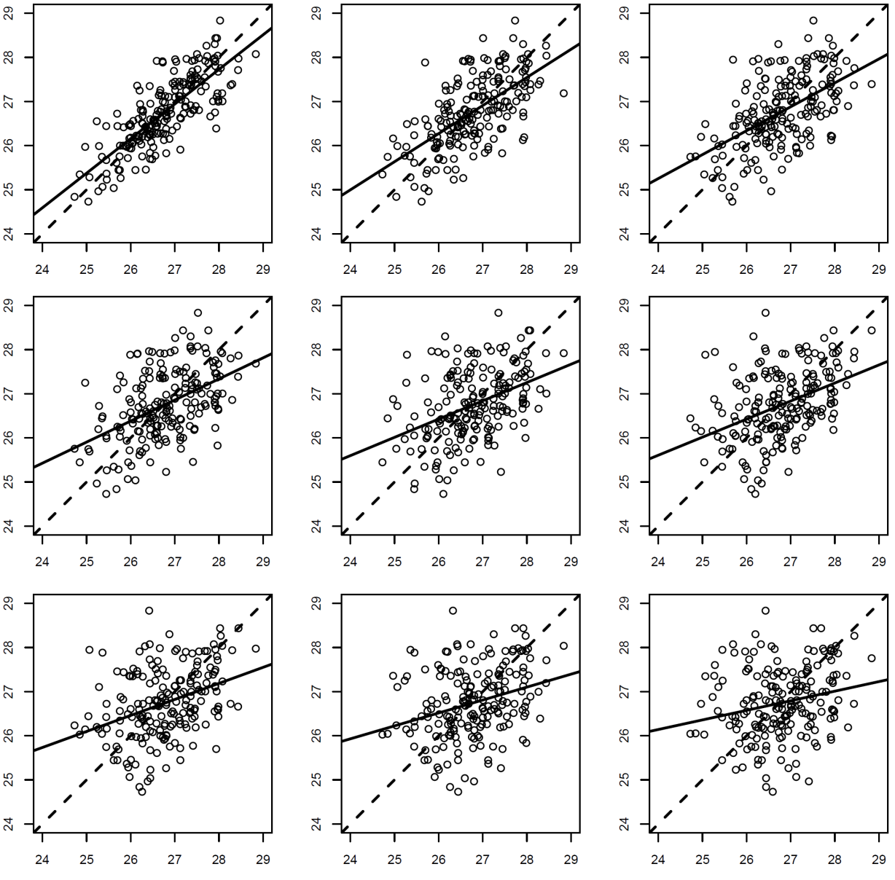
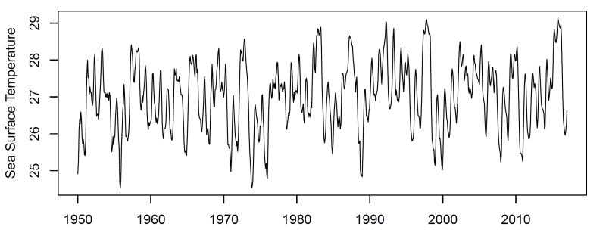
What Generates the Pattern? Key concept: correlation as a function of lag
Places closer to one another are more similar
Correlation falls away as a function of lag

Slide 13


What Generates the Pattern? Key concept: correlation as a function of lag
In space, this pervasive phenomena generates pattern
This simple fact has broad implications that can play tricks on our ideas about science!

Slide 14
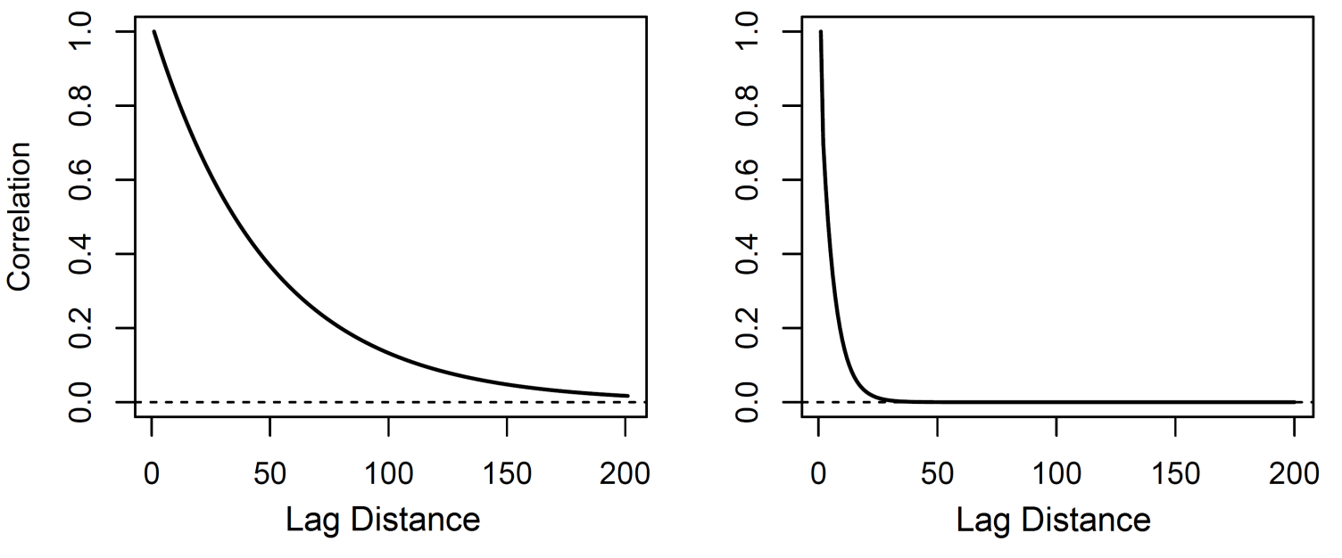
Autocorrelation functions

Slide 15
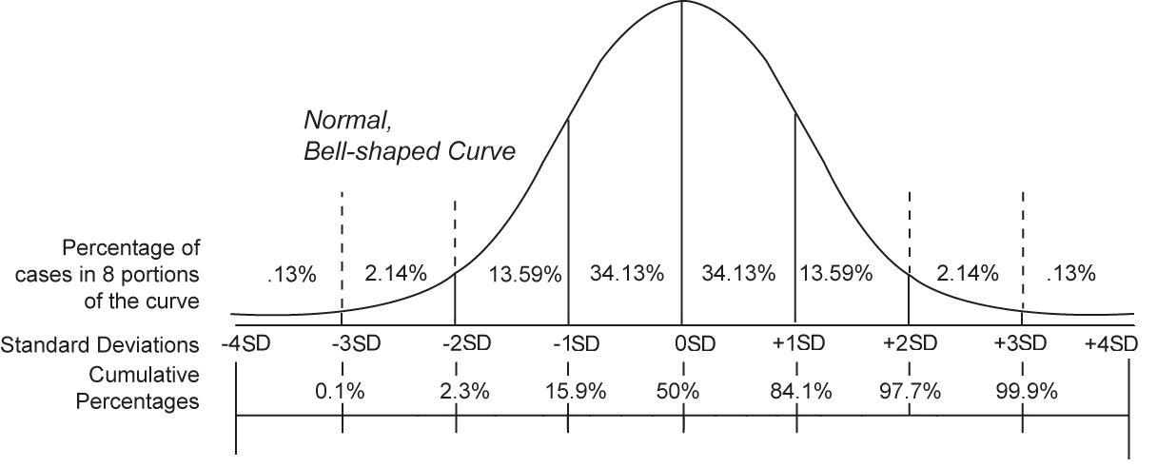
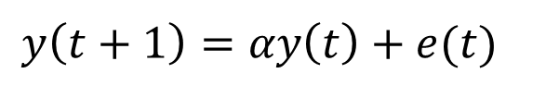
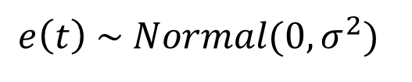
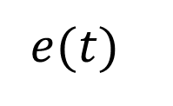
The concept of stochastic realization
$$y\left(t+1\right)=αy\left(t\right)+e(t)$$
$$e\left(t\right) \sim Normal(0,σ^{2})$$
*first-order linear autoregressive model
$$e(t)$$

Slide 16
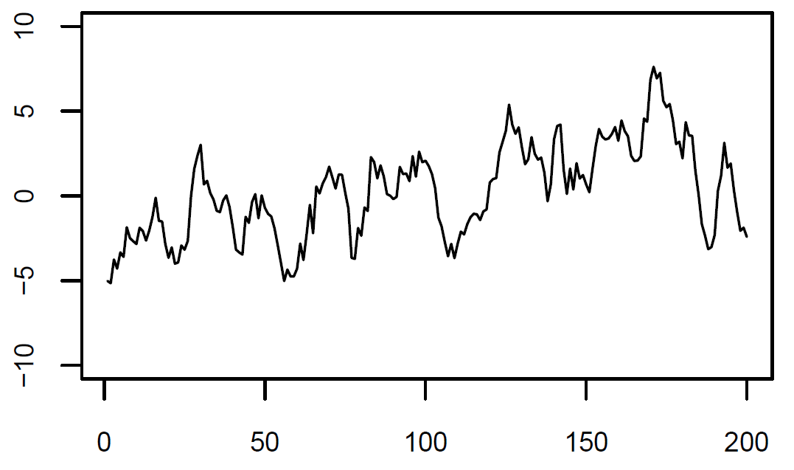
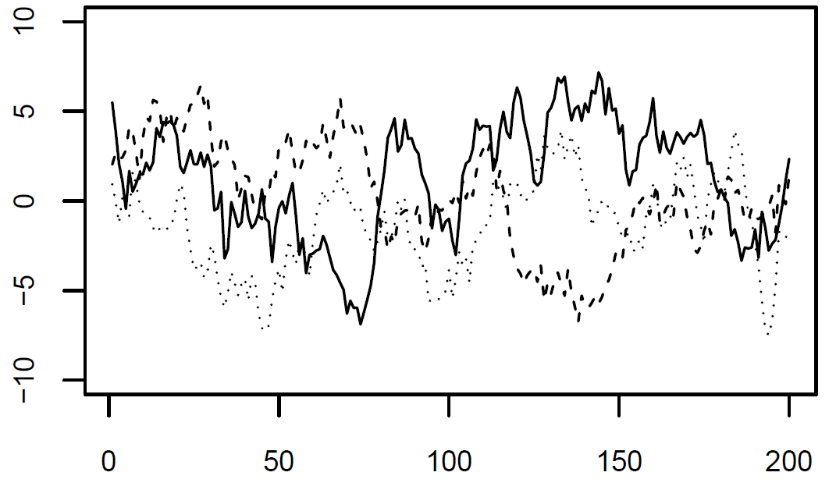
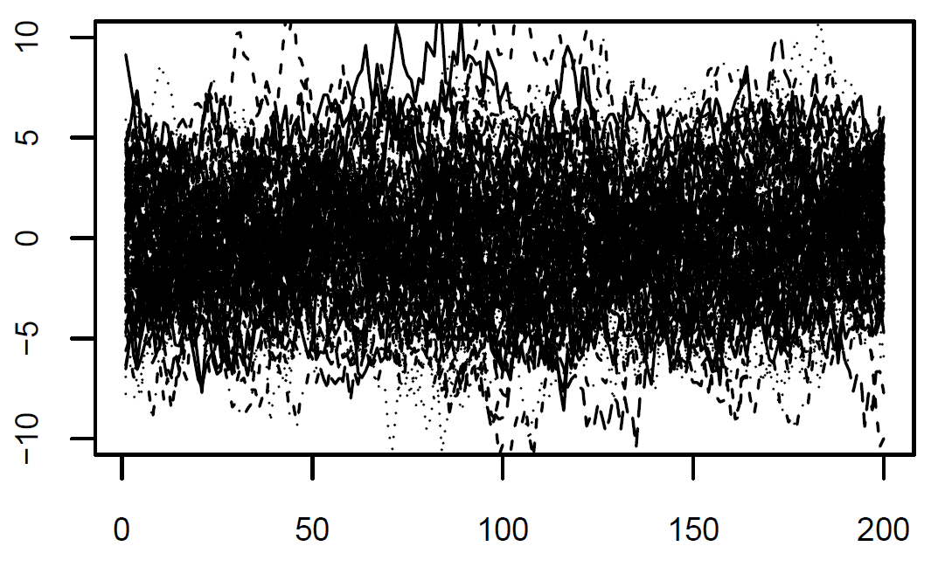
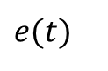
The concept of stochastic realization
$$y\left(t+1\right)=αy\left(t\right)+e(t)$$
$$e(t)$$

Slide 17
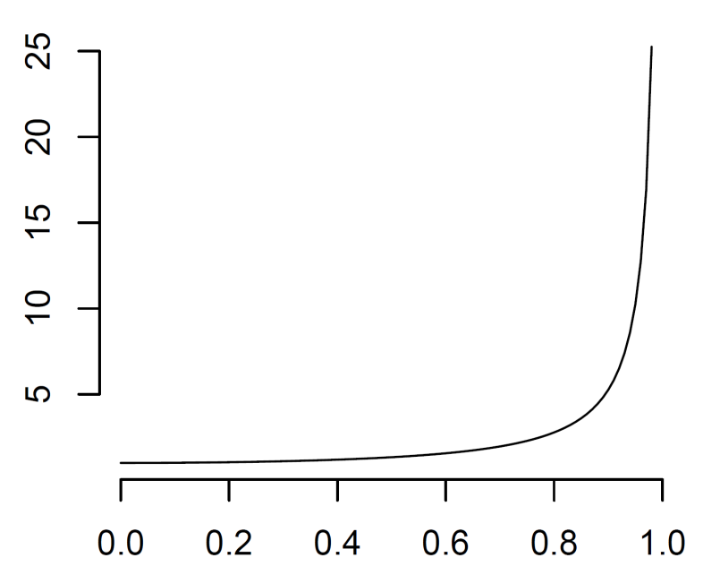
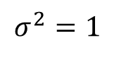
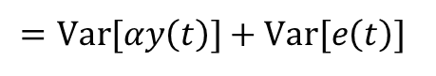
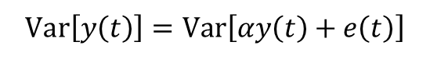
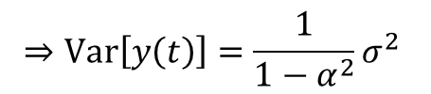
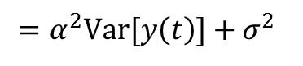
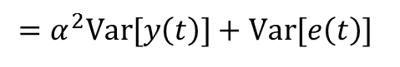
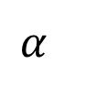
The expected variance of a temporal process
$$Var\left[y\left(t\right)\right]=Var\left[αy\left(t\right)+e\left(t\right)\right]$$
$$σ^{2}=1$$
$$=Var[αy\left(t\right)]+Var[e\left(t\right)]$$
$$=α^{2}Var[y\left(t\right)]+Var[e\left(t\right)]$$
$$=α^{2}Var[y\left(t\right)]+σ^{2}$$
$$⇒Var\left[y\left(t\right)\right]=\frac{1}{1−α^{2}}σ^{2}$$
$$α$$

Slide 18
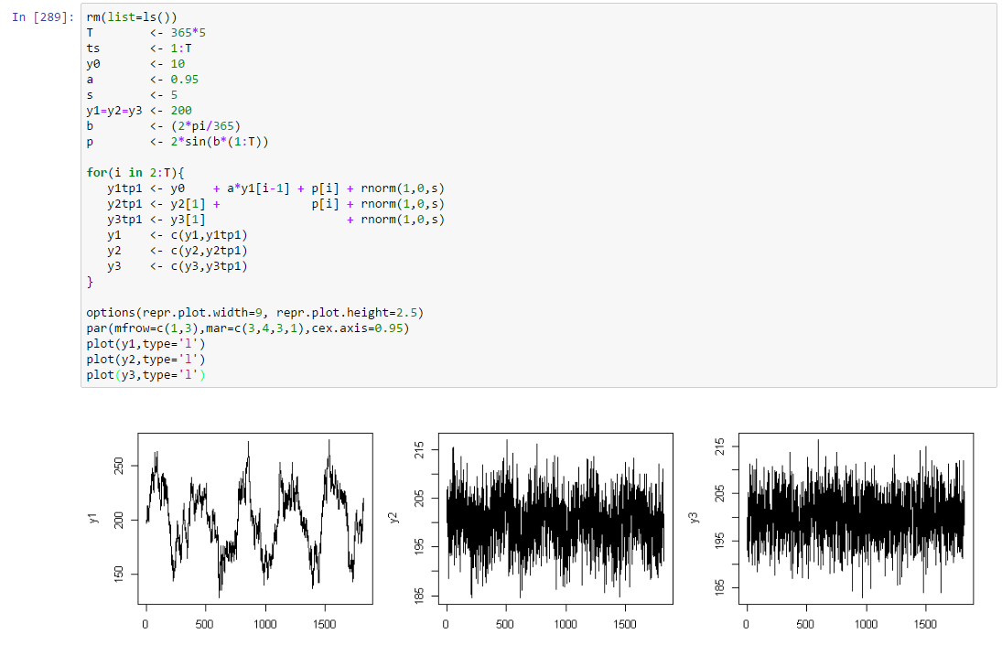
Simulate autocorrelated data (hands-on)

Slide 19
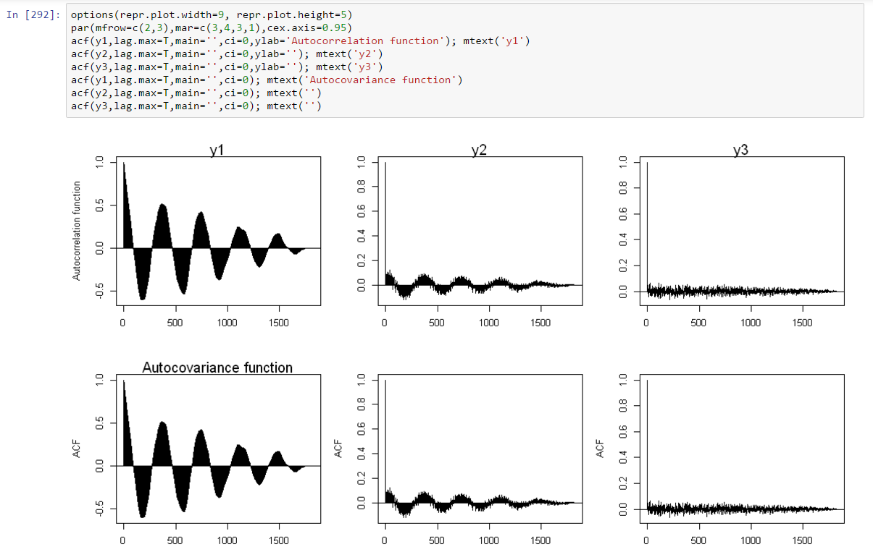
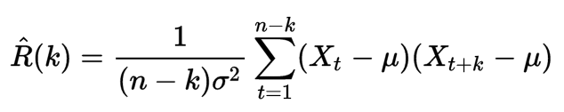
Estimate the autocorrelation function

Slide 20
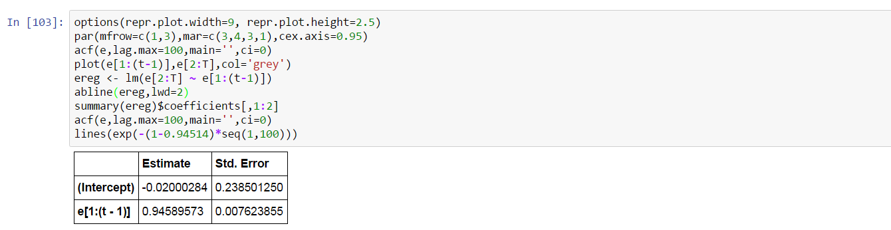
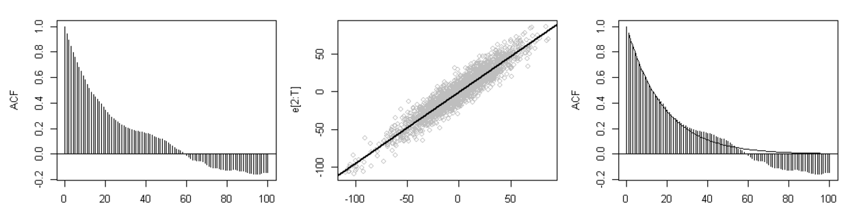
Estimate the autocorrelation function

Slide 21
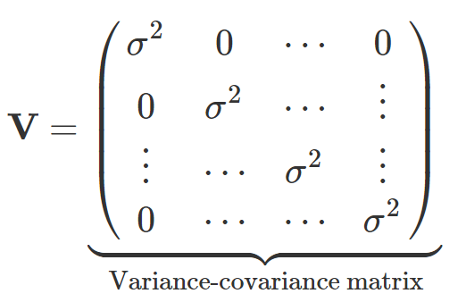
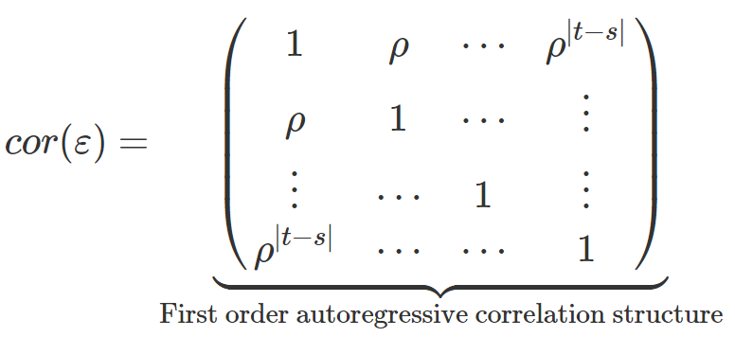
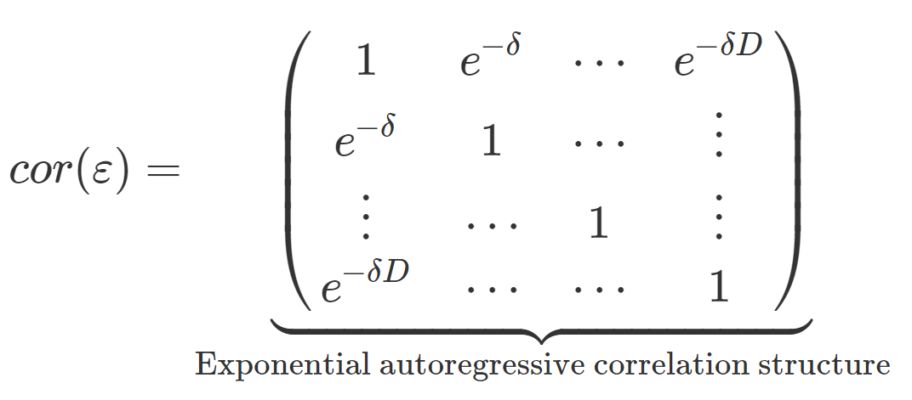
The almighty variance-covariance matrix

Slide 22
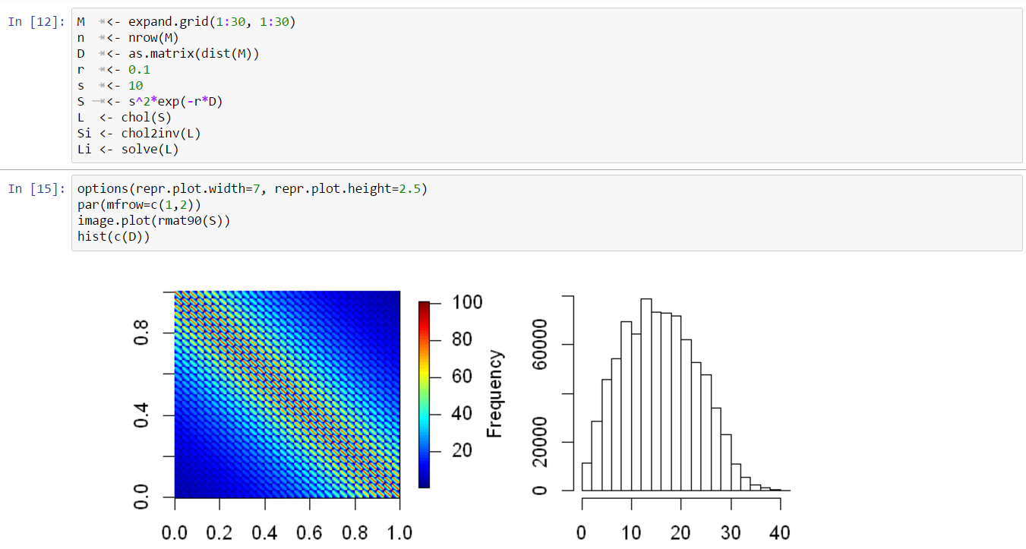
Simulate spatially autocorrelated data

Slide 23
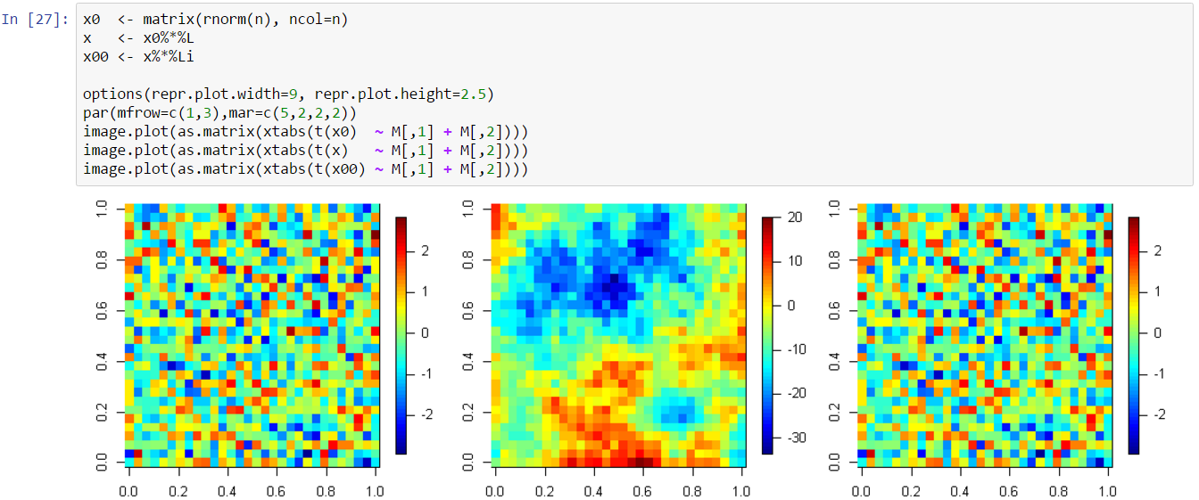
Simulate spatially autocorrelated data

Slide 24
WHY SHOULD ENVIRONMENTAL SCIENTISTS CARE?
AFTER BREAK…
Magnitude of autocorrelation controls the quantity of information in space/time data
The width of confidence intervals, p.values, posterior probabilities, and other empirical inferences depend critically on characterizing the autocorrelation, as we shall see…

Slide 25
BREAK

Slide 26

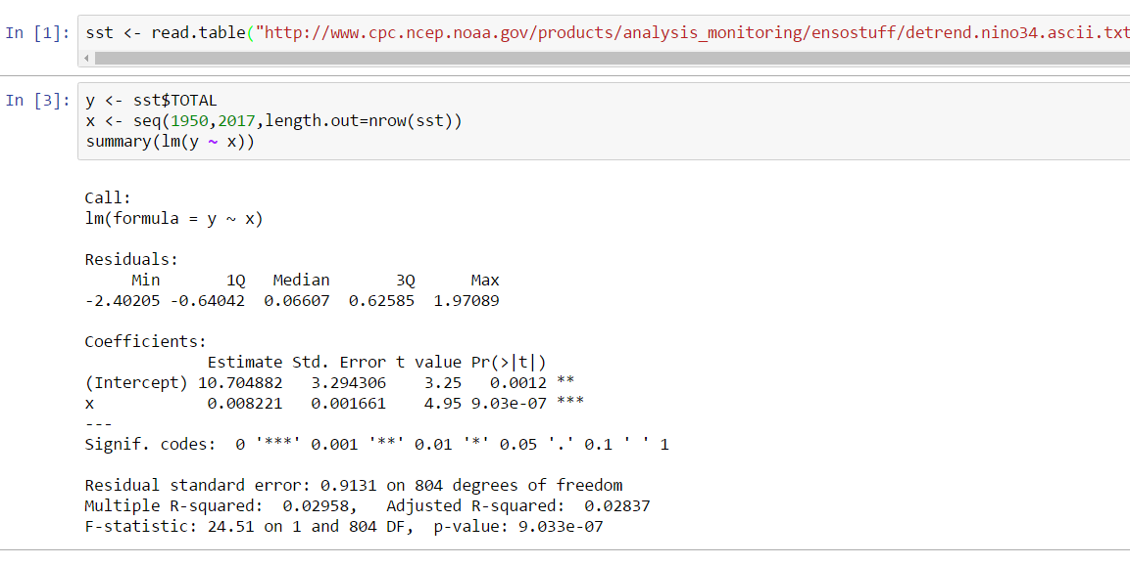
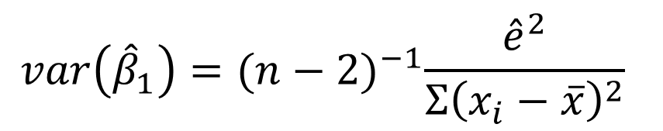
Is there a trend? ..a first attempt
$$var\left({\hat{β}}_{1}\right)={(n−2)}^{−1}\frac{{\hat{e}}^{2}}{{Σ\left(x_{i}−\overline{x}\right)}^{2}}$$
*assumes data are independent check Wikipedia for a derivation
Indicates strong evidence

Slide 27
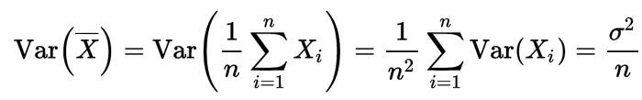
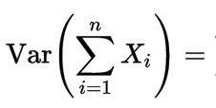
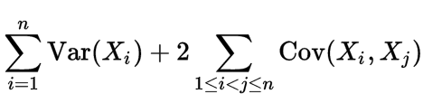
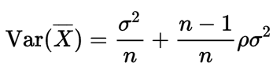
The Overconfidence of Independence
Suppose we would like to estimate a simpler quantity, the mean historical SST
*sum over elements of the covariance matrix
Assuming each pair of points Xi, Xk have correlation rho

Slide 28
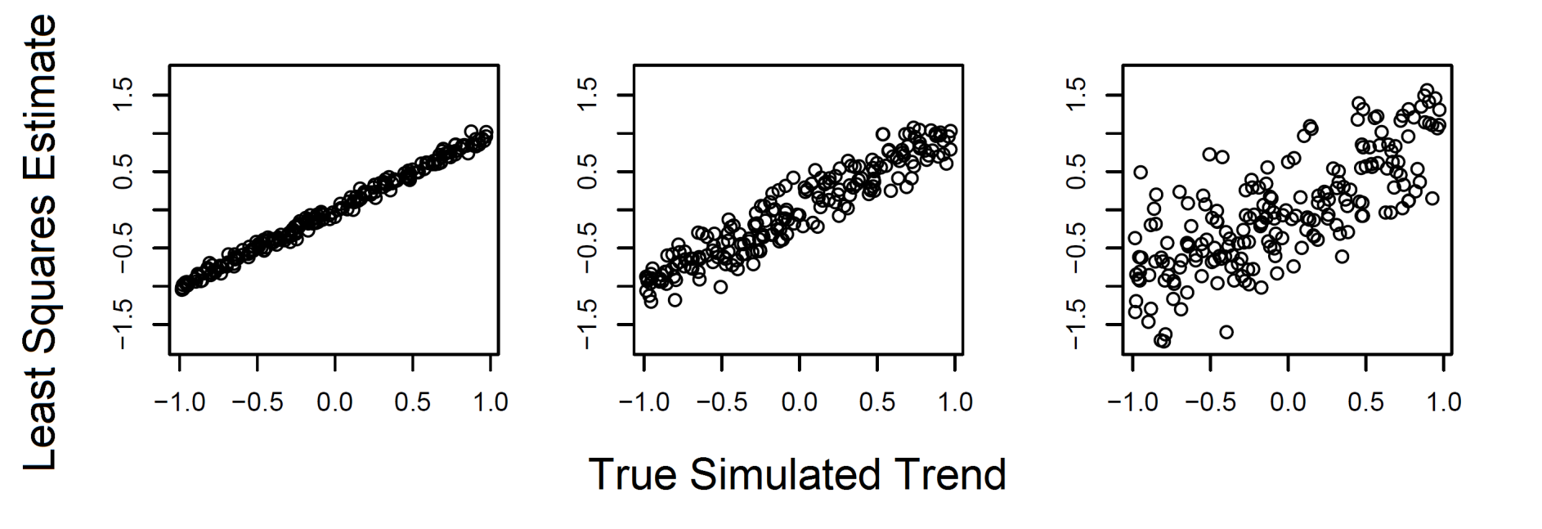



A simulated time series with known trends
Simulate 200 datasets with trends and try recovering the parameters with alpha = {0,0.5,0.95}
Variance of slope increases with autocorrelation
Basic standard error formula ignores this, like in the mean formula
Rule of thumb: n_effective(alpha) ~ (1-alpha)n
$$α=0$$
$$α=0.5$$
$$α=0.95$$

Slide 29






The statistical implications
Simulate 200 datasets with trend = 0
2*standard error misses the ‘true value’ ~ 40% of the time with $α=0.95$
$$α=0.95$$
$$α=0.5$$
$$α=0$$

Slide 30





$$α=0.95$$

Slide 31



Fitting a Model with Temporal Autocorrelation
Indicates much weaker empirical evidence!

Slide 32




Harmonic regression

Slide 33
Harmonic regression

Slide 34

Time Series Decomposition

Slide 35
Time Series Decomposition

Slide 36
Trend analysis
A temporal trend is best thought of ‘what’s left over’
This can be extremely difficult to ascertain when the dynamics of the process are not precisely known

Slide 37

Spatial Regression

Slide 38

Spatial Regression

Slide 39


Model Selection

Slide 40
LUNCH

Slide 41
Description of Environmental Datasets

Slide 42
Dataset #1: Ozone time series at single station

Slide 43
Dataset #2: Annual Climate data from Oregon

Slide 44
Dataset #3 EPA ozone monitoring sites in Southern California

Slide 45
Exercises

Slide 46
Mid-Point Jupyter Notebook Presentations (3pm)

